Slide 1
Intermediate Problem Solving
The 8D Process

Slide 2
What are the steps?
8D Stands for the 8 Disciplines of problem solving. The disciplines are:
1. Team
2. Describe
3. Contain
4. Diagnose
5. Solve
6. Validate
7. Prevent
8. Wrap-up
We will dive deeper into these in the next few slides.

Slide 3
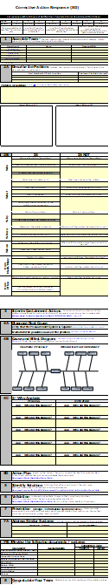
The Form Used
The form is in Excel and is used to guide the process and document the results from each step of the process.
Any report-outs, internally or externally, should be done with this form.
This form is the final document for the problem in question and is approved by management once the process has been followed.

Slide 4
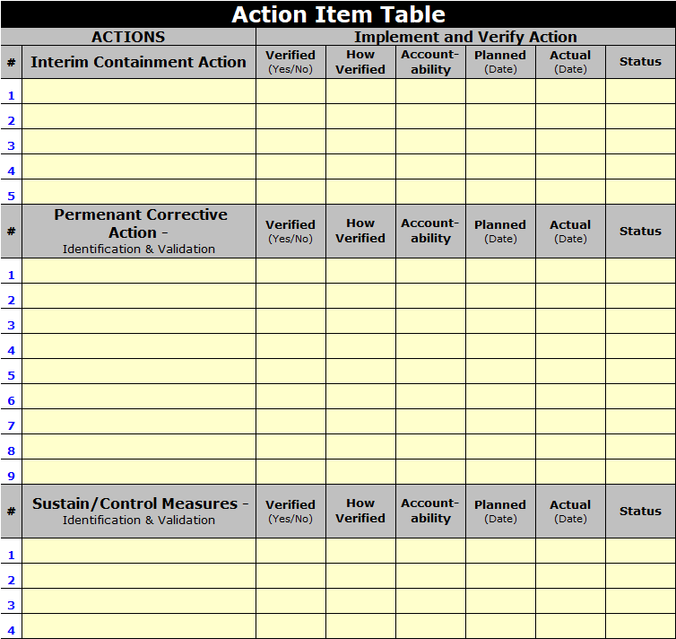
Supporting Section
As we progress, we will keep track of all the actions in the “Action Item Table” at the bottom of the 8D form.

Slide 5
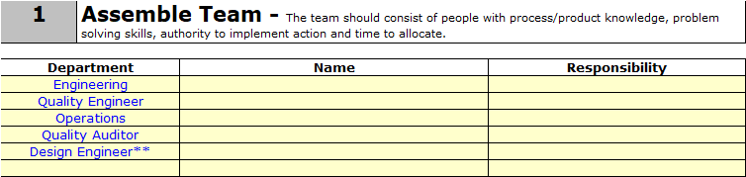
Discipline 1: Assemble the Team
We believe that most problems can be solved by ensuring the right team is around the table when trying to solve the problem.
This step in the 8D process is where this team is formed.
We have suggested the departments above. However, each problem dictates who should be involved.

Slide 6
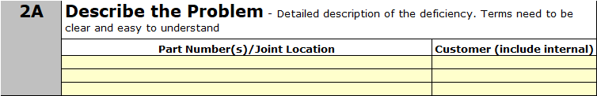
Discipline 2A: Descr. the Problem
In this section, we start with what parts and customers are affected by the problem.
List the parts and customers in the table.

Slide 7
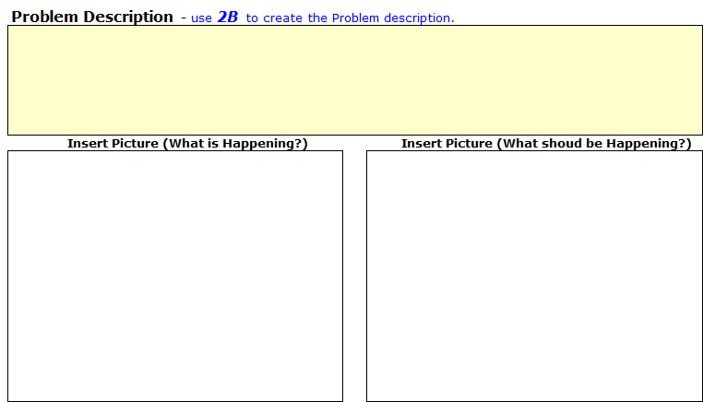
Discipline 2A: Descr. the Problem
In this section, we describe the problem and gain agreement from the team that the description is correct.
We also add pictures or visual descriptions of what is happening vs. what should be happening.

Slide 8
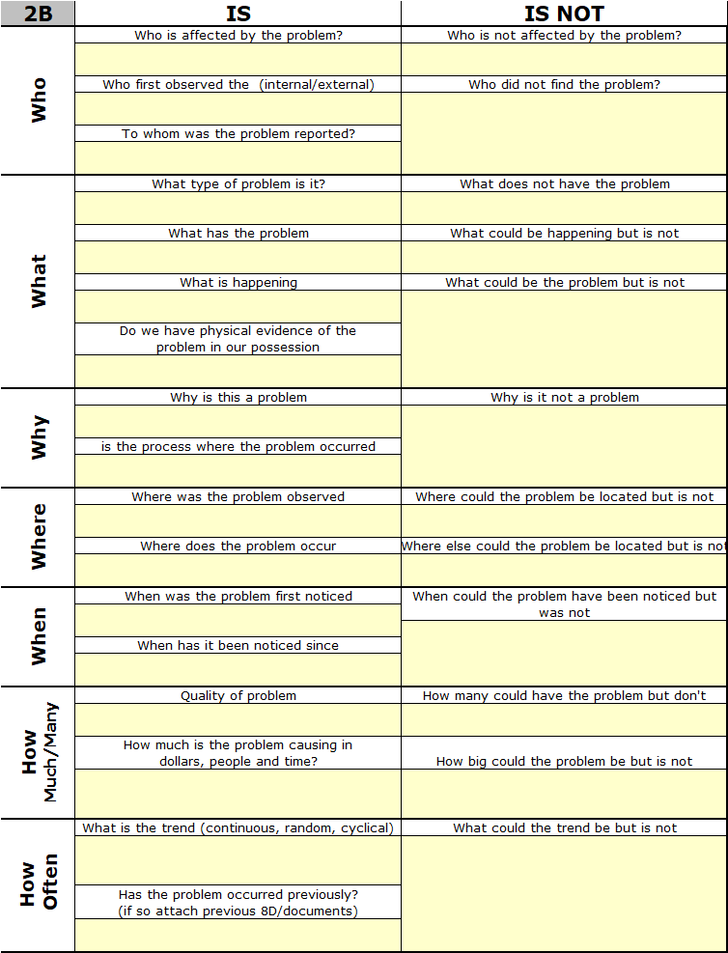
Discipline 2B: IS/IS NOT Matrix
IS/IS Not is a series of questions to be asked by the problem-solving team.
IS/IS Not analysis works by making one deliberately think about the problem and the boundaries of what it is or is not.
It thus helps to create focus and is more likely to lead to the right problem being solved.

Slide 9
Discipline 3: Interim Containment
The focus of this step is to “Stop the Bleeding” and protect the customer. It should be done ASAP.
This may require additional inspection/testing on the part of the company.
The company will earn the right to stop the additional inspection/testing by finding and eliminating the root cause to the problem.

Slide 10

Discipline 4: Diagnose Root Cause
In this step, we first ensure the measurement system has been verified. DO NOT skip this step!
Once we have proven the measurement system is adequate per the standards set forth below, we can begin brainstorming the possible causes.
  Gage R&R must be </= 10% Error and >/= 6 Distinct Categories.
    If the measurement is an attribute, we would use a Kappa Study.
  Isoplot / Youden Plot must have a discrimination ratio of >/= 6.

Slide 11
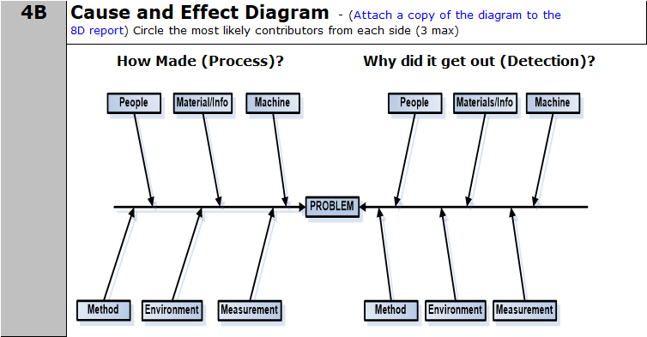
Discipline 4B: C&E Diagram
In this step, we bring the team together and brainstorm what are the possible causes of the problem.
We are looking at the problem from two different angles:
  Process Causes
  Lack of Detection

Slide 12
Discipline 4B: C&E Diagram
In both cases (process cause and failure to detect), we must focus on the process; not the person. Remember: Hard on the Process and Easy on the People.

Slide 13
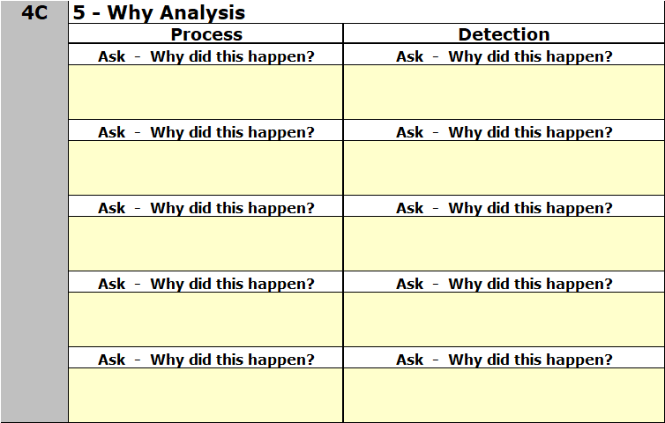
Discipline 4C: 5 Why Analysis
Once we have narrowed the list from our brainstorming to a most likely cause, we then conduct a 5 Why to get deeper at the root of the cause.
We complete the 5 Why for Process and Detection.

Slide 14
Cause Analysis - 5 Why’s
Identify potential causes by asking “Why?”
  Five Why’s
    Why?
    Why?
    Why?
    Why?
    Why? Why?
    Why?
Answer each “why” using data and facts.
A “why” that is guessed at probably means that the following “whys” will not lead to the Root Cause
Allow Splits
You do NOT have to finish the 5 Why in one meeting. The team may have to take more time to properly answer the last “why?”.
  Each “Why” answer narrows the search.
Notes:
VERY IMPORTANT: Cause analysis is the heart of the A-3 Problem solving format and the PTRS method of problem solving. Facts and Data are just that, facts and data. By themselves they do not provide the answer. Using facts and data are meant to lead you in a direction, they are not stand alone tools. Analysis, interpretation, and observation will now take over to find The Answer.
The search for the Root Cause may not follow linear thinking. Allow branches and restarts to clarify and challenge assumptions. Gather additional facts and observations as needed to uncover the Root Cause.
It is possible and actually likely that you will ask “Why” more than five times to arrive at the Root Cause.
This is the 5 Whys, not the 5 Who’s or the 5 Guesses (also not the 5 Whines) Move to the next Why after gathering Data and Facts.

Slide 15
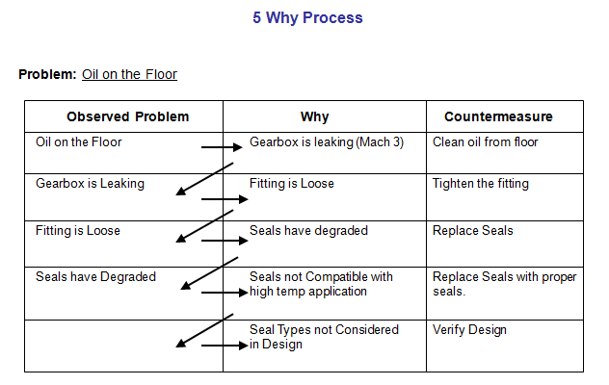
5 Why Process
> 1 Answer to WHY
Notes:
If we just clean up the floor, we haven’t really solved a problem at all. We must continue to ask WHY.
Each why can have a counter measure, but that doesn’t mean we are done. That why becomes our new problem and we have to ask Why for that problem. We repeat until we have the root cause.
There can be multiple answers to “Why,” which can trigger more 5Why’s.
The can be less or more than 5 Why’s the goal is to ask the complete number of Why’s to find the root cause.
If asked where 5Why originates: The number 5 in Japanese numerology implies perfection/completeness. You must ask “WHY” the complete number of times to reach the root cause.

Slide 16
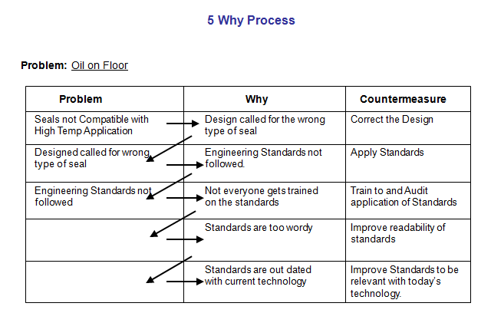
5 Why Process
The “Therefore” Test
Therefore
Notes:
The 5Why’s from the previous slide continue to this slide.
Starting at the root cause, reverse the order by saying “therefore” proceeding upward to the potential cause statement through the Problem Column. Each therefore statement should logically flow to the next. If not, start asking “Why?” again from the potential cause statement

Slide 17
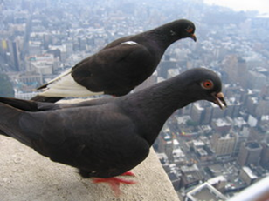
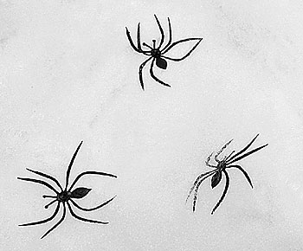
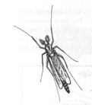
5 Why Example
The Stone on the Jefferson Memorial Was Crumbling.
  Why Was It Crumbling?
    Too Many Washings.
  Why Was It Washed So Often?
    To Remove Bird Droppings.
  Why Were There So Many Birds in the Building?
    Abundant Food Supply of Spiders.
  Why Are There So Many Spiders?
    Abundant Food Supply of Midges.
  Why Are There So Many Midges?
    Every Evening at Dusk They Emerge in a Mating Frenzy.
    At the Same Time the Park Service Turns on the Lights.
    The Midges Are Attracted to the Lights.

Slide 18

5 Why Solution
Delay the Lights Till One Hour After Sunset.
The Food Chain Was Broken and the Birds Population Drops 90%.
The Frequency of Washings Is Reduced Dramatically.

Slide 19
Discipline 4D: Action Plan
In this step, we work to validate and verify our assumptions around the root cause.
This is done at both the process and escape point.

Slide 20
Discipline 5: Identify Solutions
In this step, we have determined the best solution based on the cost and ease of implementation.
Cost
High
Low
Focus on These
High
Influence
Low

Slide 21
Discipline 6: Validation
In this step, we ensure the effectiveness of the solution.
It is extremely important to prove that our solution is indeed the solution.
We do this by turning the solution on and off randomly (6 times give us 95% confidence).

Slide 22
Discipline 7: Prevention
In this step, we determine what actions need to be taken to ensure the long-term effectiveness of the countermeasure that has been implemented.
This may require updates to the system or design.

Slide 23
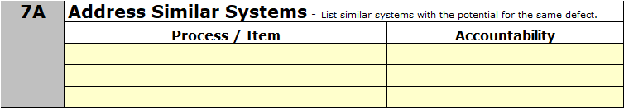
Discipline 7A: Read Across
In this step, we read across our learnings of other systems, process, parts that would benefit from our solution.
This ensures we have lessons learned; not simply lesson acknowledged.

Slide 24
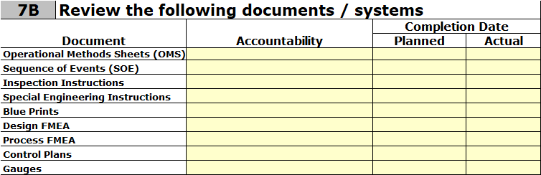
Discipline 7B: Update Documents
In this step, we review and update any documents to ensure the lesson is captured in our organizational learning framework documents.

Slide 25
Discipline 8: Congratulations
In this step, we celebrate the team’s efforts and recognize individual contributions.
In the bigger picture, we are continuing to build our problem-solving capability, which is one of the cultural enablers to Operational Excellence / CI / Lean, etc…
  Since this is a big part of helping shift our culture, we should celebrate each 8D that is closed.

Slide 26
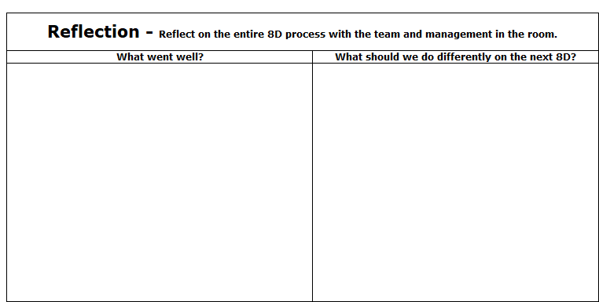
Reflection on the 8D Process
In this step, we look back at the entire process of solving this problem.
We acknowledge the things that went well.
We adjust the 8D process as needed based on the “do differently” items.

Slide 27
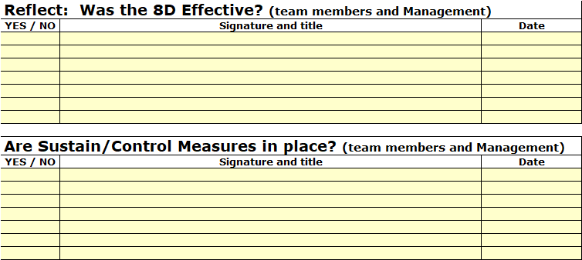
Reflection / Closure
At the end of each 8D, the team and management must reflect and acknowledge the sustainment / control measures are in place.
This puts accountability on leaders to ensure the process is followed and is effective; not just an exercise to appease a concerned customer.

Slide 28
Recommend Reading
“Analytical Trouble Shooting” by Kepner Tregoe

